Slide 1
Employee Attrition Problem
Arockia Liborious

Slide 2
Description
Following attributes are available for every employee of a company. There are two sets of data: “Existing employees” and “Employees who have left
Satisfaction Level
Last evaluation
Number of projects
Average monthly hours
Time spent at the company
Whether they have had a work accident
Whether they have had a promotion in the last 5 years
Departments (column sales)
Salary
Whether the employee has left
Problem Statement / Objective
What type of employees are leaving?
Determine which employees are prone to leave next.

Slide 3
Steps taken
Read, understand and prepare the data
Exploratory Data Analysis
Outlier Analysis / Transformation / Treatment
Modelling (Logistic, SVM & Random forest)
Model accuracy & Metrics
Final analysis and conclusions

Slide 4
Exploratory Data Analysis
Two datasets were used
Existing employees containing 11428 rows, 10 columns
Employees who have left containing 3571 rows, 10 columns
Both the datasets does not have any missing values
The percentile values for all numerical data seem to be normal indicating no significant outliers
There are two categorical variables – Salary and Department

Slide 5
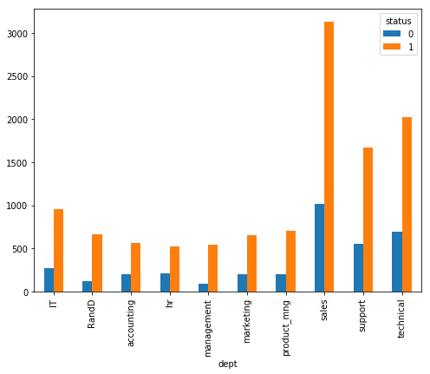
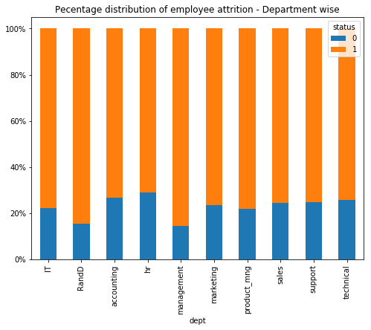
Exploratory Data Analysis
Department vs employee status shows management has least attrition percentage (w.r.t overall company).
Hence department can strong indicator of employee attrition

Slide 6
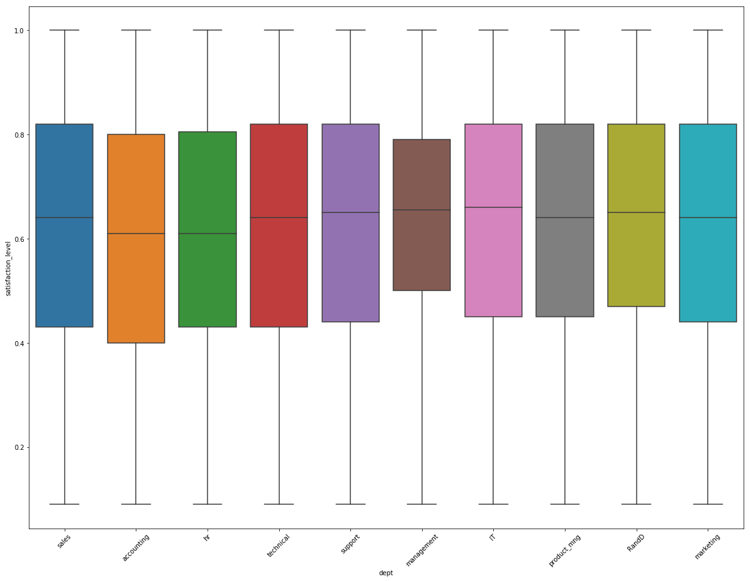
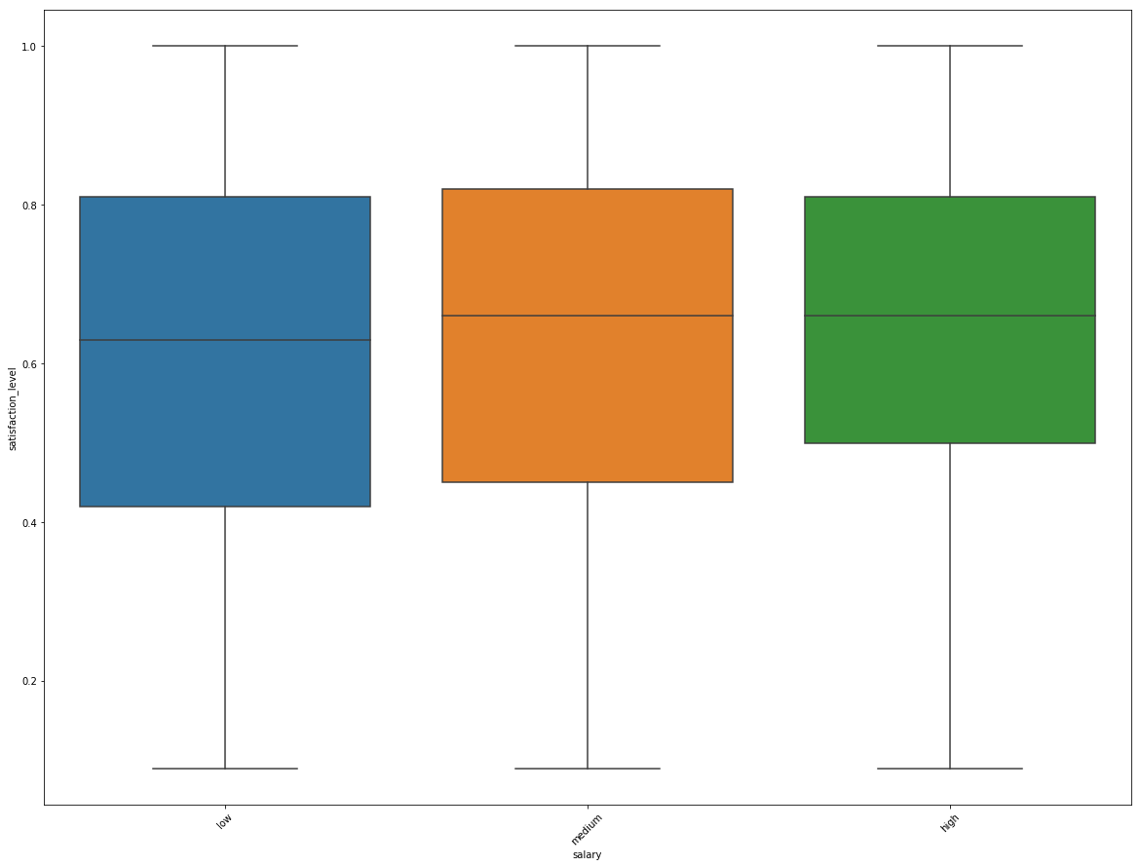
Exploratory Data Analysis
Average employee satisfaction level is highest in Management, R&D and product management department while least in HR
Average promotion is last 5 years is high in management and also the attrition is low
Low income group employee has the lower average satisfaction level

Slide 7
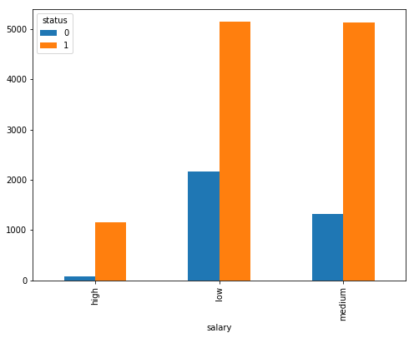
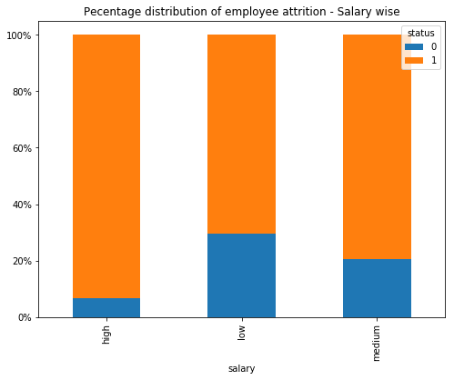
Exploratory Data Analysis
Salary vs employee status shows highly paid associates tend to stay longer
Hence salary is a strong indicator of employee attrition

Slide 8
Exploratory Data Analysis
Employees who had left the organisation have
Higher Avg. Monthly working hours
Higher Avg. number of projects
Higher Avg. Time spent at the company
Lower work accident
Employees who had stayed back have
Higher Avg. satisfaction level
Higher Avg. promotion in last 5 years
The overall attrition rate is ~23%

Slide 9
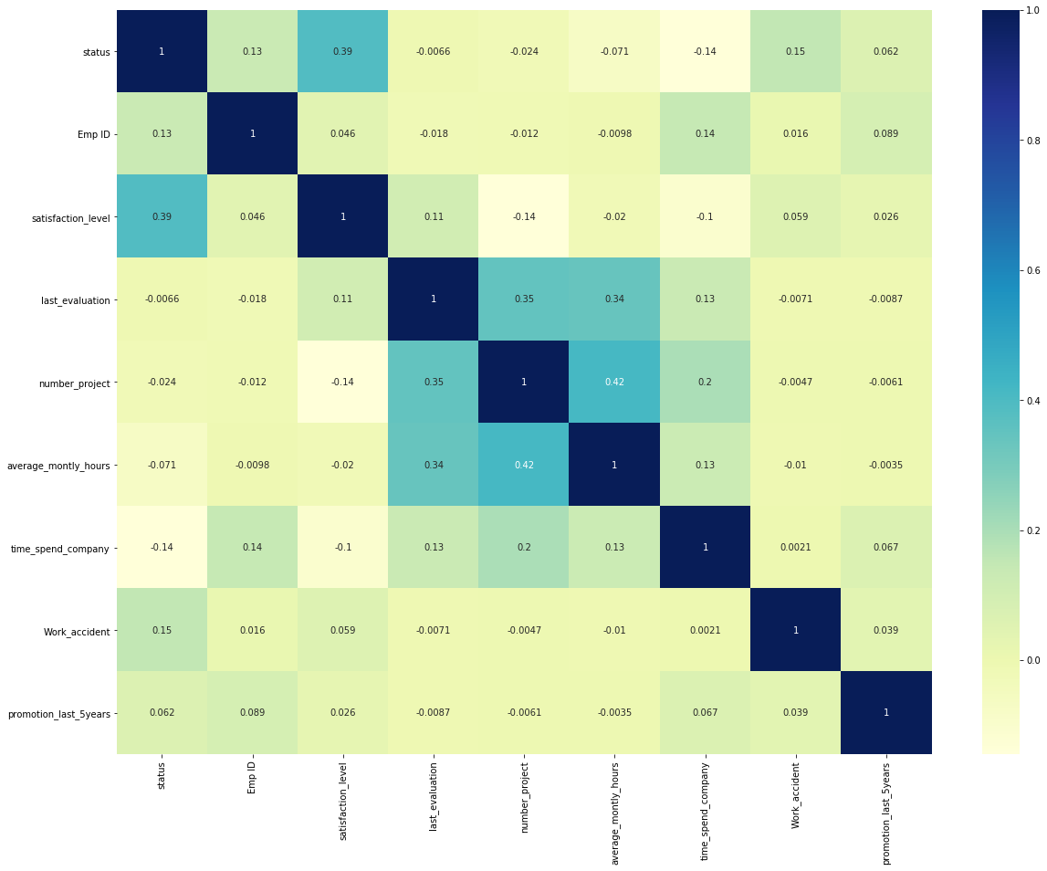
Exploratory Data Analysis
Employees who have got promoted in last 5 years tend to stay
The average monthly working hours has positive relationship with number of projects. So the hypothesis here can be people who left the compant might be overloaded with multiple projects leading to higher working hours thereby lossing the work life balance

Slide 10
Feature Selection
RFE was used to select the top 10 features
satisfaction_level
last_evaluation
time_spend_company
Work_accident
promotion_last_5years
dept_RandD
dept_hr
dept_management
salary_low
salary_medium

Slide 11
Predictive Model
The overall accuracy for various models are as follows
Logistic regression: 78.8%
Random Forest: 97.8%
Support vector machine: 94.6%
Based on this the random forest model provides the best prediction about employee attrition

Slide 12
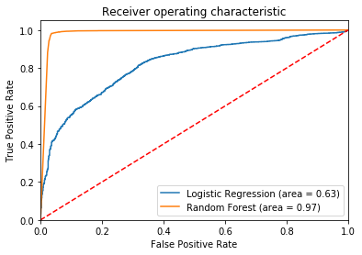
Model Metrics
The F1 Score for random forest model for 96% (left) and 99% (stayed) which is the highest among all
F1 score is the a balance between precision and recall and the model effectively tags possible employees who might leave in future.
Cross validation accuracy is at 98.6 which is also close to the random forest model accuracy indicating the model generalizes well
The ROC curve is far from the random classifier

Slide 13
Conclusion
Close to 37 current employees have a probability of staying less than 50%
These are the top priority candidates who must be taken care to avoid attrition if there is business justification to retain them
Use data wisely in conjunction with feedback from employees
Attached sheet has predicted results

